Slide 1
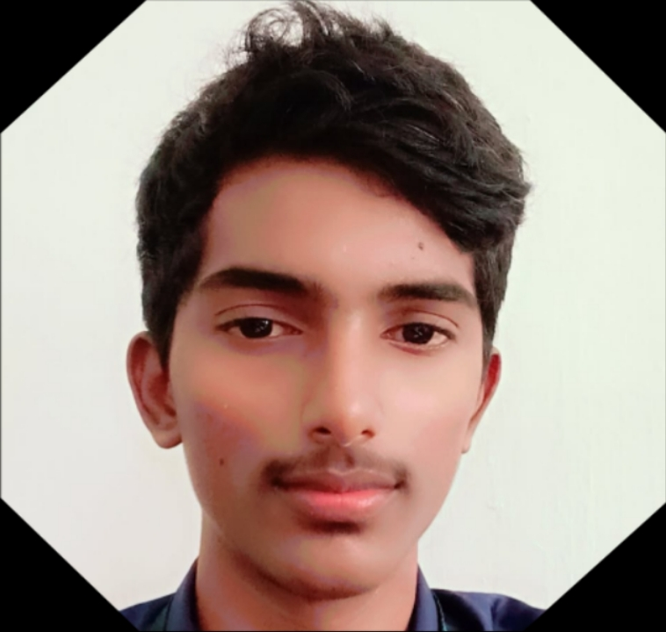
Digital Portfolio
STUDENT NAME: S.Nethran
REGISTER NO AND NMID: 31924U09018
DEPARTMENT: BCA
COLLEGE: COLLEGE/ UNIVERSITY:Mazharul Uloom College

Slide 2
PROJECT TITLE
PERSONAL DIGITAL PORTFOLIO

Slide 3


AGENDA
Problem Statement
Project Overview
End Users
Tools and Technologies
Portfolio design and Layout
Features and Functionality
Results and Screenshots
Conclusion
Github Link
3/21/2024 Annual Review

Slide 4

PROBLEM STATEMENT
In today’s digital world, students and professionals need a platform to showcase their skills, projects, and achievements. A traditional resume is not interactive and fails to demonstrate practical skills effectively.

Slide 5

PROJECT OVERVIEW
This project is a personal digital portfolio website designed to showcase:
Academic background
Technical skills
Projects and achievements
Contact details
It is responsive, user-friendly, and highlights the individual’s strengths in a professional format.

Slide 6

WHO ARE THE END USERS?
Students seeking internships or jobs
Job recruiters and HR professionals
Faculty members and evaluators
Freelance clients

Slide 7

TOOLS AND TECHNIQUES
HTML, CSS, JavaScript – for frontend design
Bootstrap / Tailwind CSS – for responsive styling
GitHub Pages / Hosting service – for deployment
VS Code – for development

Slide 8
POTFOLIO DESIGN AND LAYOUT
Modern, clean, and mobile-responsive design
Separate sections for:
About Me
Skills
Projects
Education
Contact Information
Attractive color scheme with easy navigation
8

Slide 9
FEATURES AND FUNCTIONALITY
Responsive layout (works on mobile, tablet, desktop)
Resume download option
Project showcase with screenshots
Social media / GitHub / LinkedIn links
Contact form integration

Slide 10

RESULTS AND SCREENSHOTS
Successfully designed and hosted digital portfolio
Accessible across devices
Screenshots of the homepage, projects section, and contact form
3/21/2024 Annual Review
10

Slide 11
CONCLUSION
The digital portfolio provides an effective way to highlight skills and achievements. It helps students and professionals showcase their profiles in an interactive, modern, and professional manner, making them stand out in academic and career opportunities.
11

